Slide 1
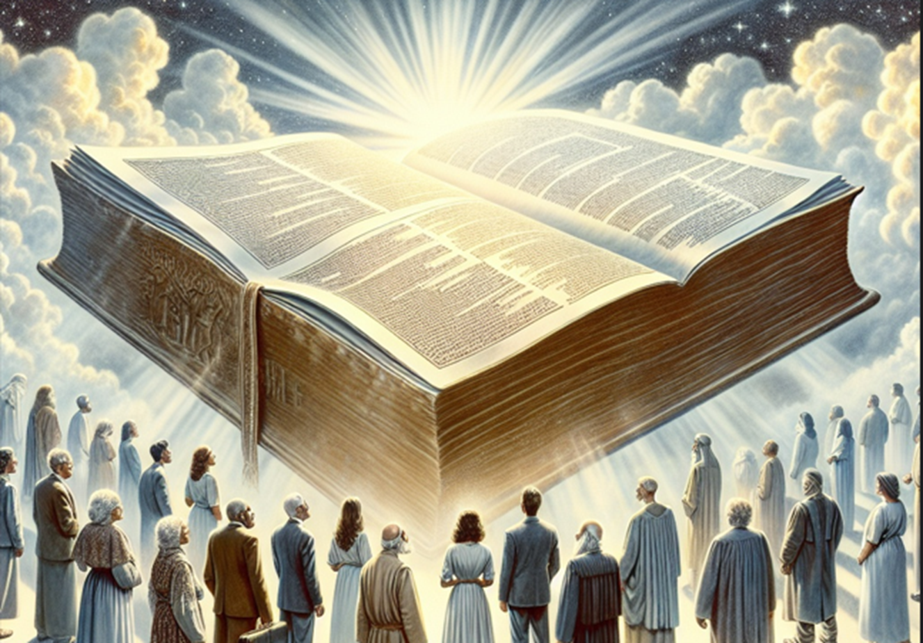
God Knows Them That Are His
II Timothy 2:19

Slide 2
II Timothy 2:19 (NASB)
Nevertheless, the firm foundation of God stands, having this seal: "The Lord knows those who are His;" and, "Everyone who names the name of the Lord is to keep away from wickedness."

Slide 3
II Timothy 2:14-19 (NASB)
¹⁴ Remind them of these things, and solemnly exhort them in the presence of God not to dispute about words, which is useless and leads to the ruin of the listeners.

Slide 4
II Timothy 2:14-19 (NASB)
¹⁵ Be diligent to present yourself approved to God as a worker who does not need to be ashamed, accurately handling the word of truth.

Slide 5
II Timothy 2:14-19 (NASB)
¹⁶ But avoid worldly and empty chatter, for it will lead to further ungodliness, ¹⁷ and their talk will spread like gangrene. Among them are Hymenaeus and Philetus,

Slide 6
II Timothy 2:14-19 (NASB)
¹⁸ men who have gone astray from the truth, claiming that the resurrection has already taken place; and they are jeopardizing the faith of some.

Slide 7
II Timothy 2:14-19 (NASB)
¹⁹ Nevertheless, the firm foundation of God stands, having this seal: "The Lord knows those who are His;" and, "Everyone who names the name of the Lord is to keep away from wickedness."

Slide 8
God Knows Them That Are His
GOD Determines Who His Children are Not Man
When Does a Human Become a Child of GOD?
Many Have Obeyed Satan the Devil and His Ministers; They do Not Have the Holy Spirit Dwelling in Their Bodies

Slide 9
Point #1: GOD Determines Who His Children are Not Man
I John 3:7-10 (NASB)
Romans 8:5-11 (NASB)
Romans 8:9 (AMPC)

Slide 10
I John 3:7-10 (NASB)
⁷ Little children, make sure no one deceives you; the one who practices righteousness is righteous, just as He is righteous; ⁸ the one who practices sin is of the devil; for the devil has been sinning from the beginning.

Slide 11
I John 3:7-10 (NASB)
The Son of God appeared for this purpose, to destroy the works of the devil. ⁹ No one who has been born of God practices sin, because His seed remains in him; and he cannot sin continually, because he has been born of God.

Slide 12
I John 3:7-10 (NASB)
¹⁰ By this the children of God and the children of the devil are obvious: anyone who does not practice righteousness is not of God, nor the one who does not love his brother and sister.

Slide 13
Romans 8:5-11 (NASB)
⁵ For those who are in accord with the flesh set their minds on the things of the flesh, but those who are in accord with the Spirit, the things of the Spirit. ⁶ For the mind set on the flesh is death, but the mind set on the Spirit is life and peace,

Slide 14
Romans 8:5-11 (NASB)
⁷ because the mind set on the flesh is hostile toward God; for it does not subject itself to the law of God, for it is not even able to do so, ⁸ and those who are in the flesh cannot please God.

Slide 15
Romans 8:5-11 (NASB)
⁹ However, you are not in the flesh but in the Spirit, if indeed the Spirit of God dwells in you. But if anyone does not have the Spirit of Christ, he does not belong to Him.

Slide 16
Romans 8:5-11 (NASB)
¹⁰ If Christ is in you, though the body is dead because of sin, yet the spirit is alive because of righteousness.

Slide 17
Romans 8:5-11 (NASB)
¹¹ But if the Spirit of Him who raised Jesus from the dead dwells in you, He who raised Christ Jesus from the dead will also give life to your mortal bodies through His Spirit who dwells in you.

Slide 18
Romans 8:9 (AMPC)
But you are not living the life of the flesh, you are living the life of the Spirit, if the [Holy] Spirit of God [really] dwells within you [directs and controls you].

Slide 19
Romans 8:9 (AMPC)
But if anyone does not possess the [Holy] Spirit of Christ, he is none of His [he does not belong to Christ, is not truly a child of God].

Slide 20
Point #2: When Does a Human Become a Child of GOD?
When GOD Puts His HOLY Spirit in His Body

Slide 21
Acts2:26-38 (NASB)
²⁶ 'THEREFORE MY HEART WAS GLAD AND MY TONGUE WAS OVERJOYED;
MOREOVER MY FLESH ALSO WILL LIVE IN HOPE; ²⁷ FOR YOU WILL NOT ABANDON MY SOUL TO HADES, NOR WILL YOU ALLOW YOUR HOLY ONE TO UNDERGO DECAY.

Slide 22
Acts2:26-38 (NASB)
²⁸ 'YOU HAVE MADE KNOWN TO ME THE WAYS OF LIFE; YOU WILL MAKE ME FULL OF GLADNESS WITH YOUR PRESENCE.'

Slide 23
Acts2:26-38 (NASB)
²⁹ "Brothers, I may confidently say to you regarding the patriarch David that he both died and was buried, and his tomb is with us to this day. ³⁰ "So because he was a prophet and knew that God had sworn to him with an oath

Slide 24
Acts2:26-38 (NASB)
to seat one of his descendants on his throne, ³¹ he looked ahead and spoke of the resurrection of the Christ, that He was neither abandoned to Hades, nor did His flesh suffer decay.

Slide 25
Acts2:26-38 (NASB)
³² "It is this Jesus whom God raised up, a fact to which we are all witnesses. ³³ "Therefore, since He has been exalted at the right hand of God, and has received the promise of the Holy Spirit from the Father,

Slide 26
Acts2:26-38 (NASB)
He has poured out this which you both see and hear. ³⁴ "For it was not David who ascended into heaven, but he himself says: 'THE LORD SAID TO MY LORD, "SIT AT MY RIGHT HAND, ³⁵ UNTIL I MAKE YOUR ENEMIES A FOOTSTOOL FOR YOUR FEET."'

Slide 27
Acts2:26-38 (NASB)
³⁶ "Therefore let all the house of Israel know for certain that God has made Him both Lord and Christ—this Jesus whom you crucified.“ ³⁷ Now when they heard this, they were pierced to the heart, and said to Peter and the rest of the apostles,

Slide 28
Acts2:26-38 (NASB)
"Brothers, what are we to do?" ³⁸ Peter said to them, "Repent, and each of you be baptized in the name of Jesus Christ for the forgiveness of your sins; and you will receive the gift of the Holy Spirit.

Slide 29
Acts 5:32 (NASB)
And we are witnesses of these things; and so is the Holy Spirit, whom God has given to those who obey Him.

Slide 30
Romans 8:9 (NASB)
However, you are not in the flesh but in the Spirit, if indeed the Spirit of God dwells in you. But if anyone does not have the Spirit of Christ, he does not belong to Him.

Slide 31
I Corinthians 6:19-20 (NASB)
¹⁹ Or do you not know that your body is a temple of the Holy Spirit within you, whom you have from God, and that you are not your own? ²⁰ For you have been bought for a price: therefore glorify God in your body.

Slide 32
I Corinthians 3:16-17 (NASB)
¹⁶ Do you not know that you are a temple of God and that the Spirit of God dwells in you? ¹⁷ If anyone destroys the temple of God, God will destroy that person; for the temple of God is holy, and that is what you are.

Slide 33
I John 3:24 (NASB)
The one who keeps His commandments remains in Him, and He in him. We know by this that He remains in us, by the Spirit whom He has given us.

Slide 34
Point #3: Many Have Obeyed Satan the Devil and His Ministers; They do Not Have the Holy Spirit Dwelling in Their Bodies
II Corinthians 11:14-15 (KJV)
II Timothy 2:24-26 (NASB)

Slide 35
II Corinthians 11:14-15 (KJV)
¹⁴ And no marvel; for Satan himself is transformed into an angel of light.
¹⁵ Therefore it is no great thing if his ministers also be transformed as the ministers of righteousness; whose end shall be according to their works.

Slide 36
II Timothy 2:24-26 (NASB)
²⁴ The Lord's bond-servant must not be quarrelsome, but be kind to all, skillful in teaching, patient when wronged, ²⁵ with gentleness correcting those who are in opposition,

Slide 37
II Timothy 2:24-26 (NASB)
if perhaps God may grant them repentance leading to the knowledge of the truth, ²⁶ and they may come to their senses and escape from the snare of the devil, having been held captive by him to do his will.

Slide 38
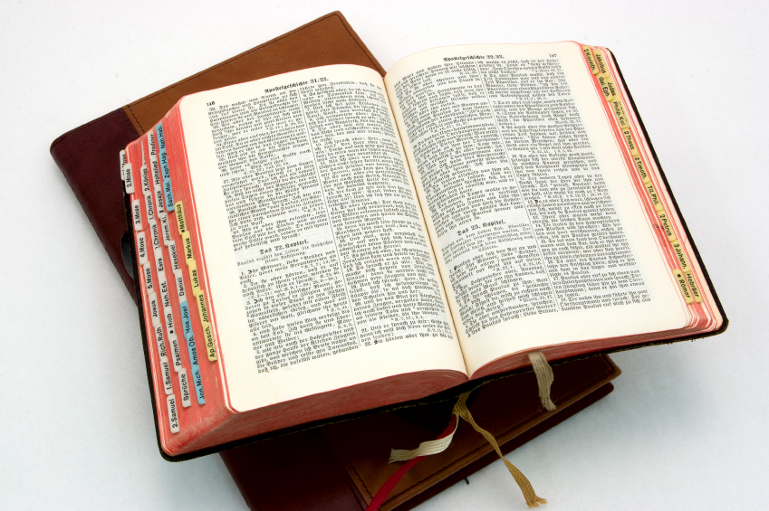
Hear: Romans 10:17
So then faith cometh by hearing, and hearing by the word of God.

Slide 39
Believe: Hebrews 11:6
But without faith it is impossible to please him: for he that cometh to God must believe that he is, and that he is a rewarder of them that diligently seek him.

Slide 40
Repent: Luke 13:3
I tell you, Nay: but, except ye repent, ye shall all likewise perish.

Slide 41
Confess: Matthew 10:32-33
32 Whosoever therefore shall confess me before men, him will I confess also before my Father which is in heaven.
33 But whosoever shall deny me before men, him will I also deny before my Father which is in heaven.

Slide 42
Baptize: Acts 22:16
And now why tarriest thou? arise, and be baptized, and wash away thy sins, calling on the name of the Lord.

